Slide 1
Thank You
This PowerPoint document contains the images that you requested.
Copyright Notice
All materials on this Site are protected by United States copyright law and may not be reproduced, distributed, transmitted, displayed, or otherwise published without the prior written permission of Wolters Kluwer. You may not alter or remove any trademark, copyright or other notice.
However, provided that you maintain all copyright, trademark and other notices contained therein, you may download material (one machine readable copy and one print copy per page) for your personal, non-commercial use only. Please refer to this link for further information on how to
apply for permission for re-use
Any information posted to discussion forums (moderated and un-moderated) is for informational purposes only. We are not responsible for the information or the result of its practice.

Slide 2
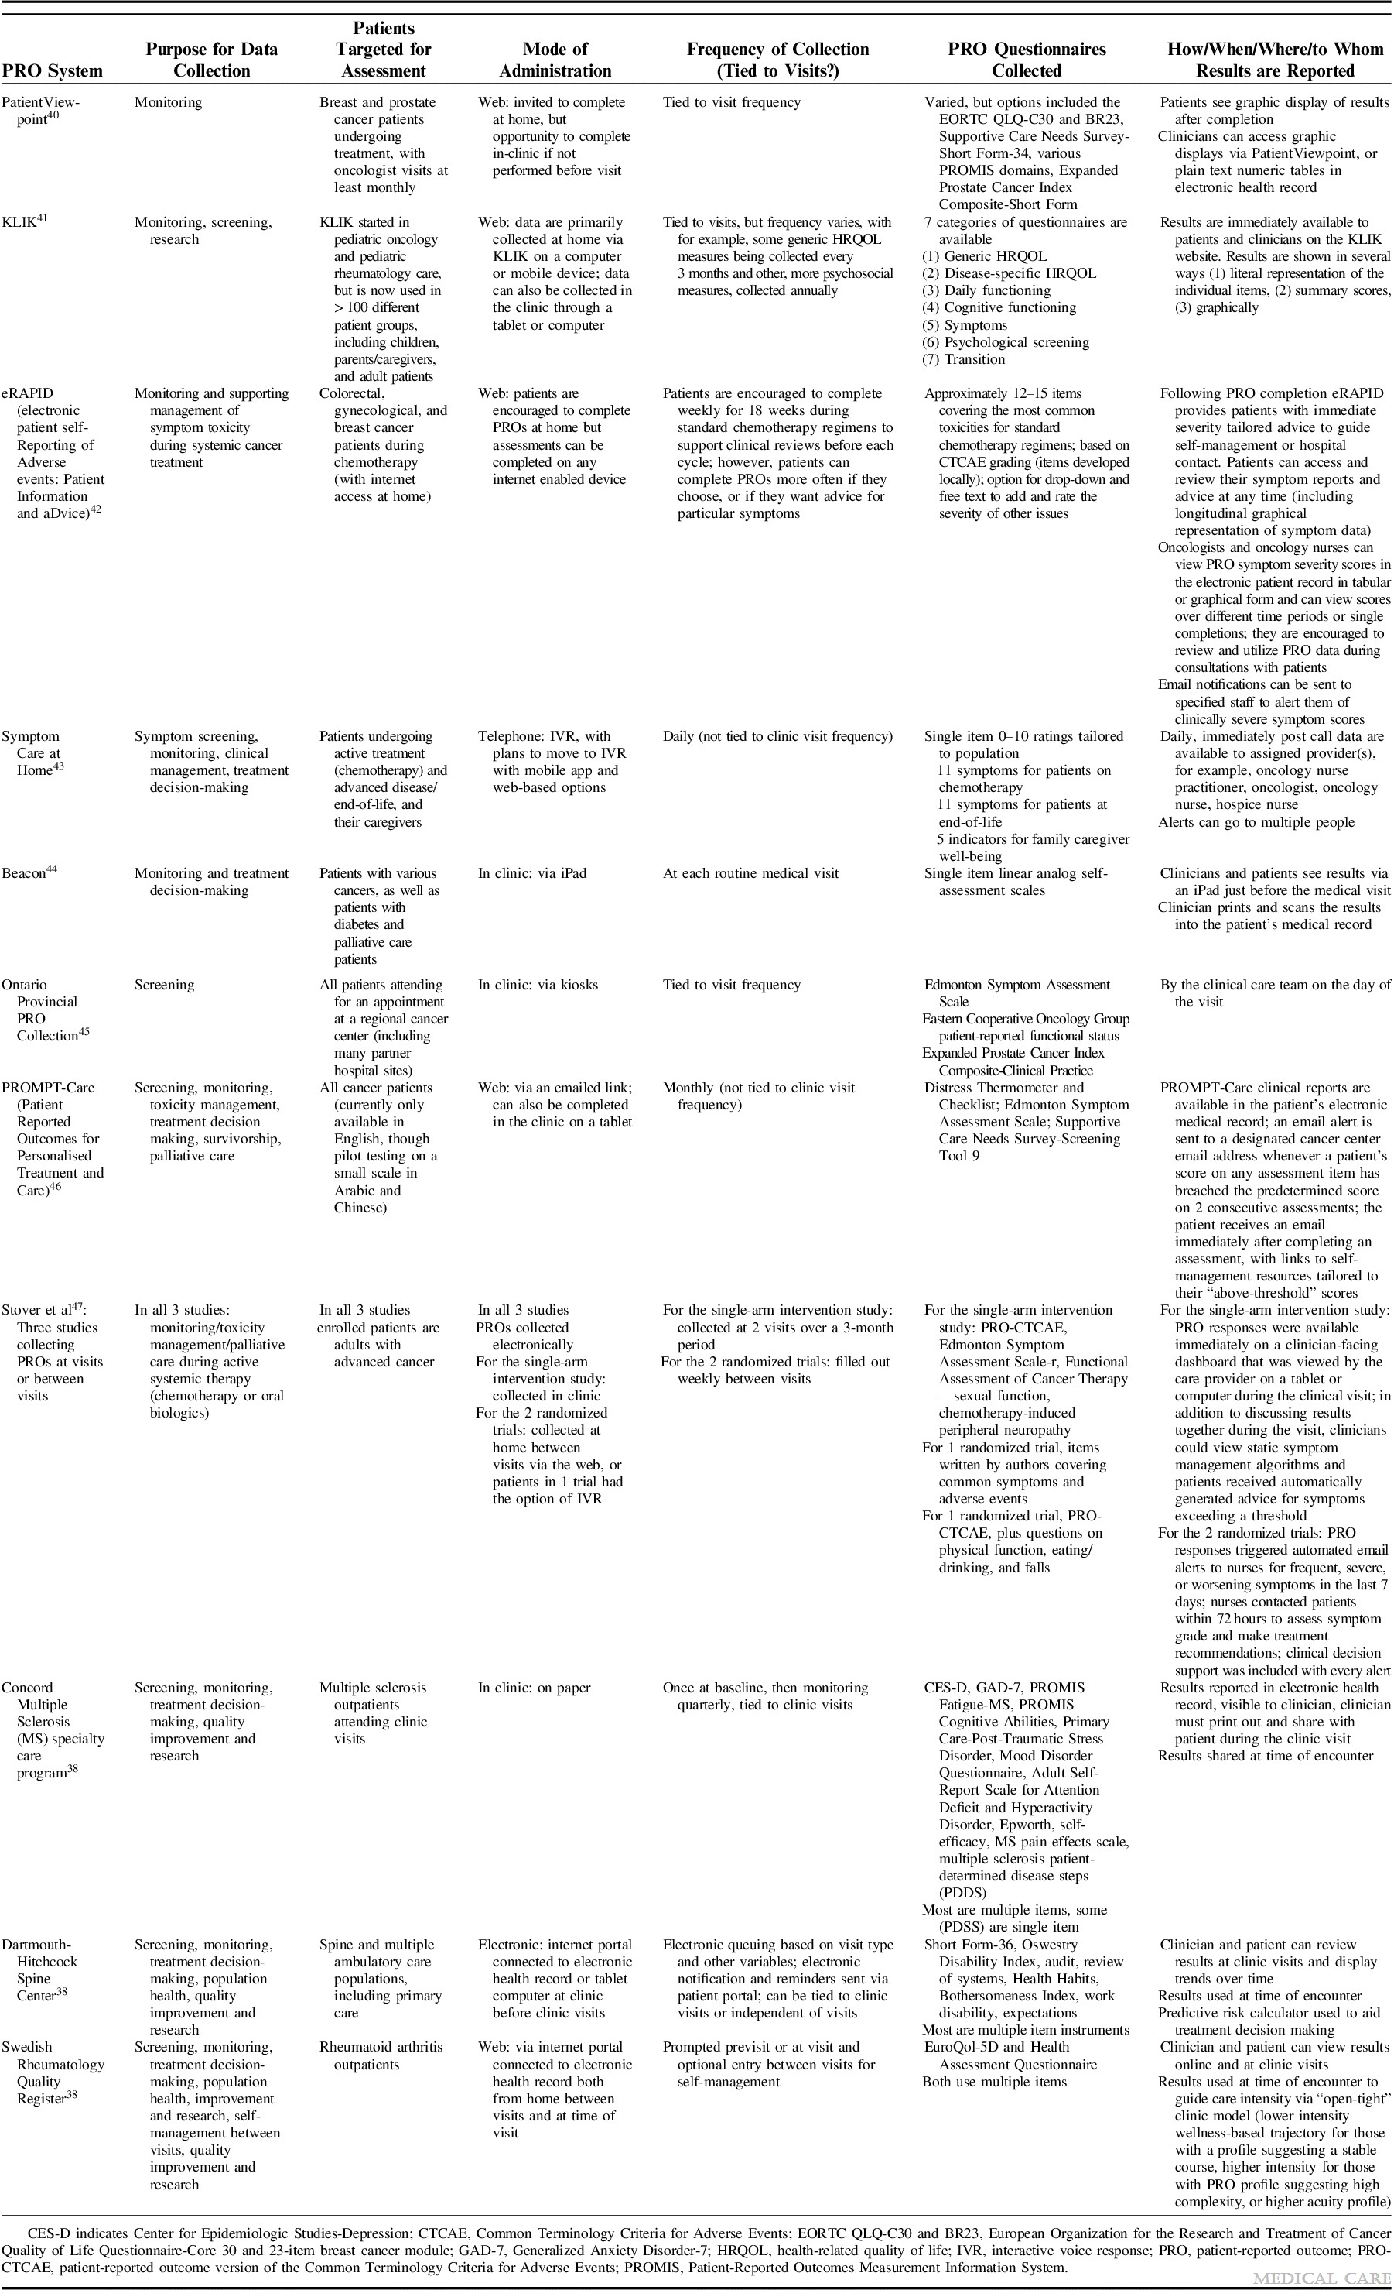
TABLE 1
A PRO-cision Medicine Methods Toolkit to Address the Challenges of Personalizing Cancer Care Using Patient-Reported Outcomes: Introduction to the Supplement
Snyder, Claire; Brundage, Michael; Rivera, Yonaira M.; Wu, Albert W.
Medical Care57:S1-S7, May 2019.
doi: 10.1097/MLR.0000000000001089
Characteristics of PRO Systems Described in PRO-cision Medicine Methods Toolkit Paper Series

