Slide 1
Childhood Adversity and Toxic Stress
Donald A. Barr, MD, PhD
Professor of Pediatrics, and of Education (by courtesy)
Stanford University

Slide 2
Presenter Disclosures
Donald A. Barr, MD, PhD
(1) The following personal financial relationships with commercial interests relevant to this presentation existed during the past 12 months:
I receive royalties from Johns Hopkins University Press for four books I have written.

Slide 3
Shonkoff JP, et al. Pediatrics. 2012 Jan;129(1):e232-46.
“Many adult diseases should be viewed as developmental disorders that begin early in life and that persistent health disparities associated with poverty, discrimination, or maltreatment could be reduced by the alleviation of toxic stress in childhood.”

Slide 4
Toxic stress: “When a child experiences strong, frequent, and/or prolonged adversity—such as physical or emotional abuse, chronic neglect, caregiver substance abuse or mental illness, exposure to violence, and/or the accumulated burdens of family economic hardship—without adequate adult support.”
- Center on the Developing Child, Harvard University
http://developingchild.harvard.edu/science/key-concepts/toxic-stress/

Slide 5
The Origins of Adult Health Disparities
Health-Related Behaviors
Cancer
Toxic Stress in Childhood
Cardiovascular Disease
Premature mortality
Stress-Induced Physiologic Injury

Slide 6
McEwen BS. Protective and damaging effects of stress mediators. New England Journal of Medicine. 1998; 338(3):171-9.
“The physiologic systems activated by stress can not only protect and restore but also damage the body.”
“The price of this accommodation to stress can be allostatic load, which is the wear and tear that results from chronic over-activity…of allostatic systems.”

Slide 7
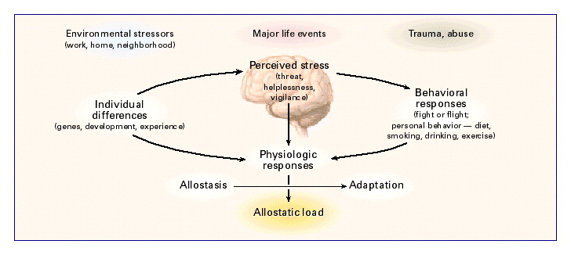
The Stress Response and Development of Allostatic Load.
McEwen BS. Protective and damaging effects of stress mediators. N Engl J Med. 1998; 338(3):171-9.
Cardiovascular and neurologic injury
Chronic stress in childhood
Chronically elevated
serum cortisol

Slide 8
Salivary cortisol is the most common measure of chronic stress
Elevated in 13-year-olds who had lived a higher proportion of their life since birth in poverty (Evans & Kim. Psychol Sci. 2007; 18(11): 953-7)
Elevated in kindergarten children from high-adversity families (Obradović et al. Child Dev. 2010; 81(1): 270-89)
Elevated in 2-4 year old children facing chronic poverty and living in lower quality housing (Blair et al. Dev Psychopathol. 2011; 23(3): 845-57)

Slide 9
Chronic Increase in Stress Hormones
(principally cortisol)
Chronic Increase in Allostatic Load
Inflammation in Cells Lining the Inner Wall of Small Arteries
Increase in Inflammatory Markers in the Blood
Increased Stiffness of the Walls of the Blood Vessel
Scarring of the Walls of the Blood Vessel

Slide 10
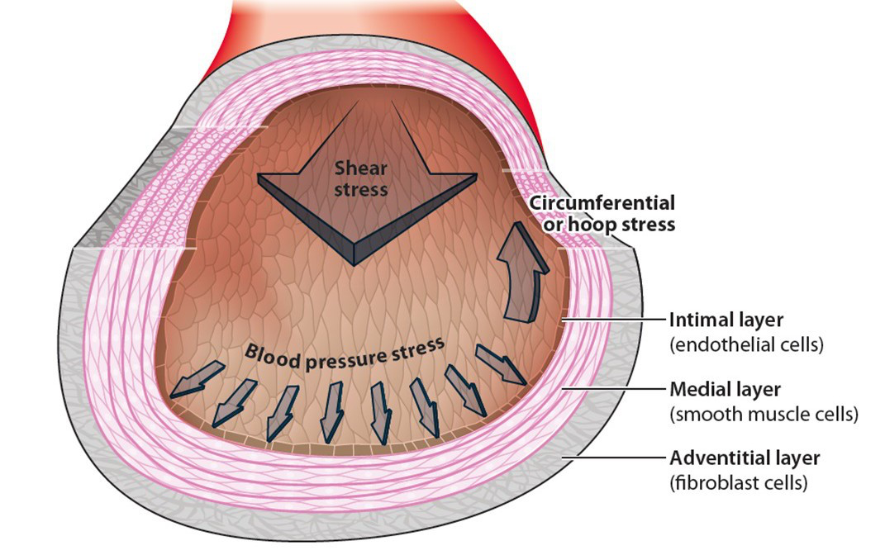
Tarbell et al. Annu Rev Fluid Mech. 2014; 46:591-614.

Slide 11
Prediction of Clinical Cardiovascular Events With Carotid Intima-Media Thickness – A Systematic Review and Meta-Analysis. Lorenz, et al. Circulation. 2007; 14: 459-67.
“Carotid intima-media thickness (IMT) is increasingly used as a surrogate marker for atherosclerosis…Carotid IMT is a strong predictor of future vascular events.”

Slide 12
Racial and socioeconomic disparities in arterial stiffness and intima media thickness among adolescents Thurston RC, Matthews KA. Social Science & Medicine 2009; 68:807
Recruited students age 14-16
Recorded race, SES (multiple measures)
Asked students to self-rate their position in the “social hierarchy”
3 years later, they measured
Carotid IMT
pulse wave velocity of the blood flowing through the aorta (measures stiffness of the lining)

Slide 13
Results:
African American subjects had higher IMT and higher pulse wave velocity than white subjects
Lower SES subjects had higher IMT and higher pulse wave velocity than higher SES subjects
African American subjects had lower SES than white subjects
When measuring both race and SES, race showed no difference, but SES continued to show a difference

Slide 14
Chronically elevated levels of cortisol can also have toxic effects on neurological development in young children.

Slide 15
At a Success Academy Charter School, Singling Out Pupils Who Have ‘Got to Go’
By Kate Taylor Oct. 29, 2015
“From the time Folake Ogundiran’s daughter started kindergarten at a Success Academy charter school in Fort Greene, Brooklyn, the girl struggled to adjust to its strict rules. She racked up demerits for not following directions or not keeping her hands folded in her lap. Sometimes, after being chastised, she threw tantrums. She was repeatedly suspended for screaming, throwing pencils, running away from school staff members or refusing to go to another classroom for a timeout.”

Slide 16
Building the Brain’s “Air Traffic Control” System: How Early Experiences Shape the Development of Executive Function - Center on the Developing Child at Harvard University (2011)
“Children’s executive function skills provide the link between early school achievement and social, emotional, and moral development…Young children who have problems staying focused and resisting urges to respond impulsively—two core executive function skills—not only have trouble in school but also have trouble following directions generally...”

Slide 17
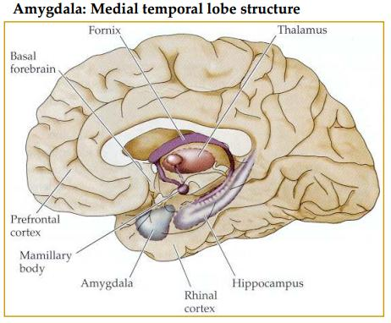
Source: http://tnaaustralia.org.au/2015/12/11/amygdala-function-in-pain/

Slide 18
Shonkoff JP, et al. Pediatrics. 2012 Jan;129(1):e232-46.
“Chronic stress is associated with hypertrophy and overactivity in the amygdala and orbitofrontal cortex, whereas comparable levels of adversity can lead to loss of neurons and neural connections in the hippocampus and medial PFC.”

Slide 19
Salivary cortisol mediates effects of poverty and parenting on executive functions in early childhood. Blair, et al. Child Dev. 2011 Nov-Dec;82(6):1970-84.
“Executive functions contribute substantially to the self-regulation of behavior and are central to early academic achievement.”
“Higher level of salivary cortisol assessed at ages 7, 15, and 24 months was uniquely associated with lower executive function ability and to a lesser extent IQ at age 3 years.”

Slide 20
“The functional consequences of these structural changes include more anxiety related to both hyperactivation of the amygdala and less top-down control as a result of [Pre-Frontal Cortex] atrophy as well as impaired memory and mood control as a consequence of hippocampal reduction.”

Slide 21
Leveraging the biology of adversity to address the roots of disparities in health and development. - Shonkoff JP. Proc Natl Acad Sci U S A. 2012; 109 Suppl 2:17302-7
“At the time of school entry, children differ in how well they are able to focus and shift their attention, manage their feelings, control their impulses, follow rules and directions, and adapt to a variety of other demands.”
“Many teachers contend that beginning school with a solid base of these foundational skills in executive function and self-regulation is more important than whether children know letters and numbers.”

Slide 22
The Stress Response and Development of Allostatic Load.
Chronic stress in childhood
Reduced educational attainment
Impaired executive function at school entry
Elevated
serum cortisol
Increased cardiovascular disease
Early atherosclerosis in adolescence

Slide 23
Increased behaviors that are harmful to health (e.g., smoking, obesity)
Reduced educational attainment
Increased cardiovascular disease

Slide 24
We should view the chronic elevation in cortisol that results from high levels of stress in early childhood as a toxin, as potentially harmful to young children as lead or other toxins, take steps to identify children at risk, and adopt interventions shown to reduce stress.

Slide 25
BUT…..
“Assertions that the die has been cast by the time the child enters school are not supported by neuroscience evidence and can create unwarranted pessimism about the potential efficacy of interventions that are initiated after the preschool years.”
Shonkoff and Phillips. From Neurons to Neighborhoods: The Science of Early Childhood Development. National Academy Press, Washington, D.C. 2000

