Slide 1
Lifecourse Social Conditions and Racial and Ethnic Patterns of Cognitive Aging
Jennifer Manly
APHA Oct 2016

Slide 2
Presenter Disclosures
Jennifer Manly, PhD
(1) The following personal financial relationships with commercial interests relevant to this presentation existed during the past 12 months:
No relationships to disclose

Slide 3
Collaborators
Maria Glymour
Adam Brickman
Christopher Weiss
Karen Siedlecki
Wei-Ming Watson
Laura Zahodne
Sze Liu
Yaakov Stern
Richard Mayeux
Nicole Schupf
Supported by
NIA R01 AG16206, AG028786, RF1 AG054070 (PI: Manly)
NIA R01 AG037212 (PI: Mayeux)

Slide 4
Overview
Evidence for disparities in cognitive aging and Alzheimer’s disease
Methodological challenges to AD disparities research
  Prevalence vs. incidence
  Intercept vs. slope
  Neuropsychological assessment across racial/linguistic groups
  Selection bias
  Survival effect and possible crossover effect
Lifecourse social mechanisms of racial disparities in AD

Slide 5
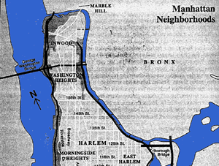


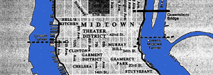



Washington Heights/Hamilton Heights/Inwood Columbia Aging Project (WHICAP)
N = 2125 in 1992, added 2174 in 1999
Age 65 and older
Women (68%) outnumbered men (32%), consistent with age group
Tested in Spanish (37%) or English (63%)
Seen in home at 18 – 24 month intervals
Dx based on neuropsychological test battery, medical & functional interview
INWOOD
WASHINGTON HEIGHTS
HAMILTON HEIGHTS

Slide 6
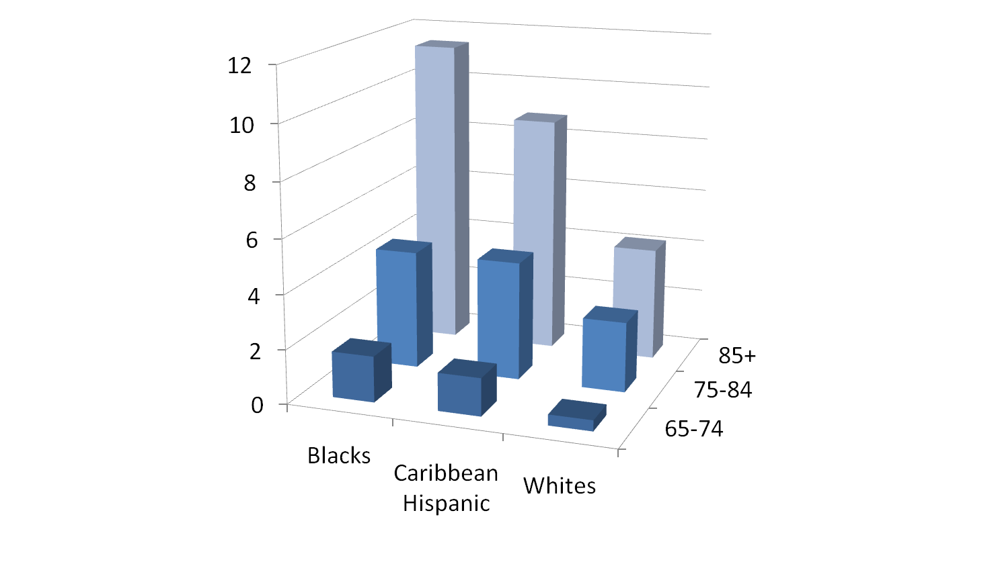
Evidence of Disparities
Incidence of AD by Age and Race/Ethnicity WHICAP 2001
Annual age-specific incidence
Tang et al., 2001; Neurology 56: 49-56
Notes:
Adjusting for cardiovascular disease, education, and APOE E4 allele did not alter the magnitude of these inequities

Slide 7
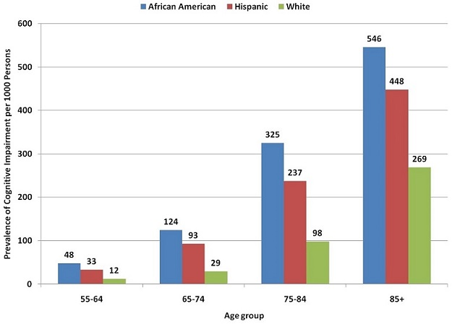
Evidence of Disparities
Prevalence of Cognitive Impairment by Age and Race/Ethnicity HRS 2006
Alzheimer’s Association, 2010
Notes:
among Americans Aged 55 and Older (rate per 1,000 population)
Prevalence studies can’t show cognitive decline clearly

Slide 8
Evidence of Disparities
Kaiser Permanente Northern California
Mayeda et al., 2016
Notes:
Kaiser Permanente Northern California, a large, integrated health care delivery system
members age 60 and older
Compared incident cases of dementia (all subtypes) according to medical records - ICD-9 codes - across racial/ethnic groups.
Asian Americans were least likely to develop dementia and therefore were set as the reference group.
African Americans 65% more likely to develop dementia, than Asian Americans
American Indians and Alaska Natives were 32% more likely than Asian Americans, disparities were wider among men than women
Differences in age of onset - lifetime risk is high for all groups

Slide 9
Methodological challenges to disparities research on cognitive aging and dementia

Slide 10
Selection Bias
Differences in recruitment across racial/ethnic groups may lead to non-generalizable results
  Ethnic minority participants may not be broadly representative of the community
  Consider how barriers to participation may influence sample characteristics and bias results
Racial and ethnic minorities are less likely to present to Memory Disorders Clinics, are less likely to receive a formal diagnosis of AD than non-Hispanic Whites
  Minorities who present to clinics are more likely to have neuropsychiatric symptoms than Whites

Slide 11
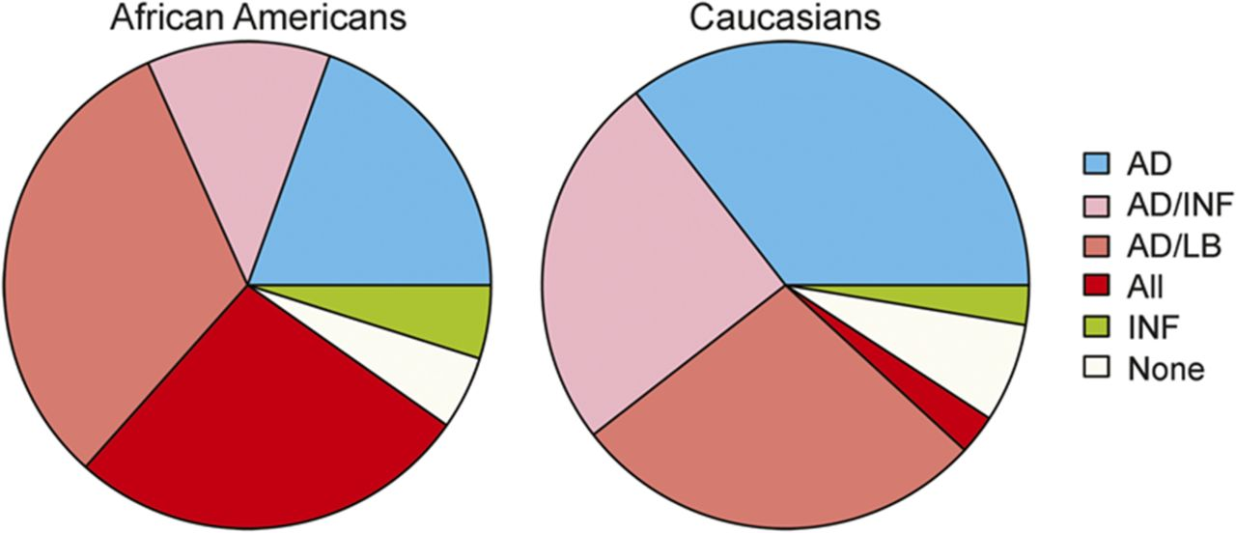
Racial differences in mixed pathology in black and white decedents with Alzheimer disease (AD) dementia
Barnes et al. Neurology 2015
Notes:
Racial differences in mixed pathology Pie chart shows proportions of individual and mixed pathologies in black and white decedents with Alzheimer disease (AD) dementia. INF = infarcts; LB = Lewy bodies.

Slide 12
Survival Bias
Mortality is higher, at all ages, among racial/ethnic minorities and those with low education as compared to Whites/high educated
The smaller group of people of color who live to be studied as older adults are hardier than the larger group of Whites.
Hardiness is probably related to an unobserved characteristic.
Even if the unmeasured factor was not initially related to race (for example, specific genes), selective survival could bias estimates of the effect of race on mortality, both exaggeration or reversal of the effect of race on mortality can occur
This bias is not just present for mortality but for any health outcome that can occur just once (like dementia)
Glymour, Weuve, & Chen (2008)

Slide 13

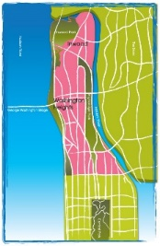
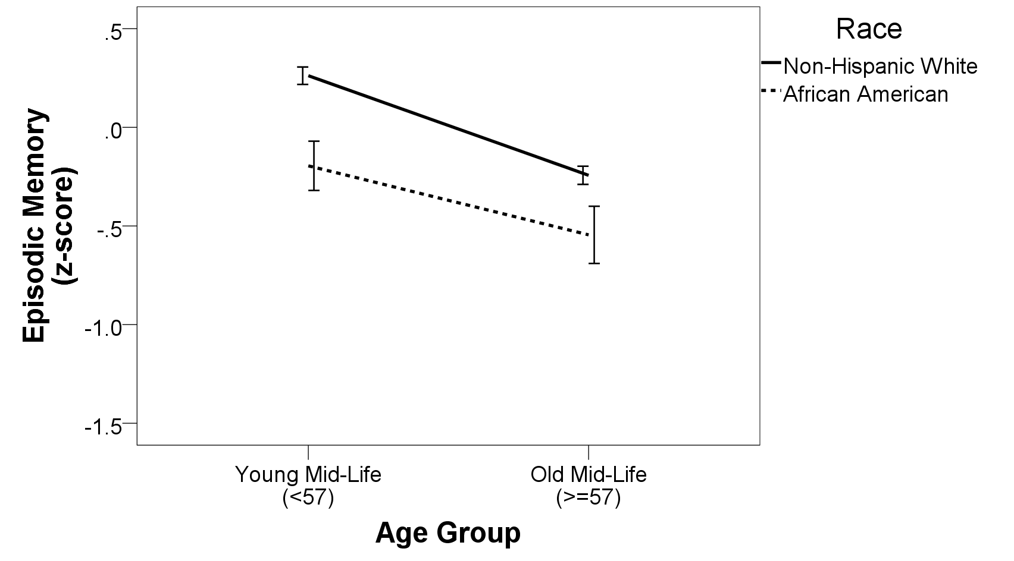
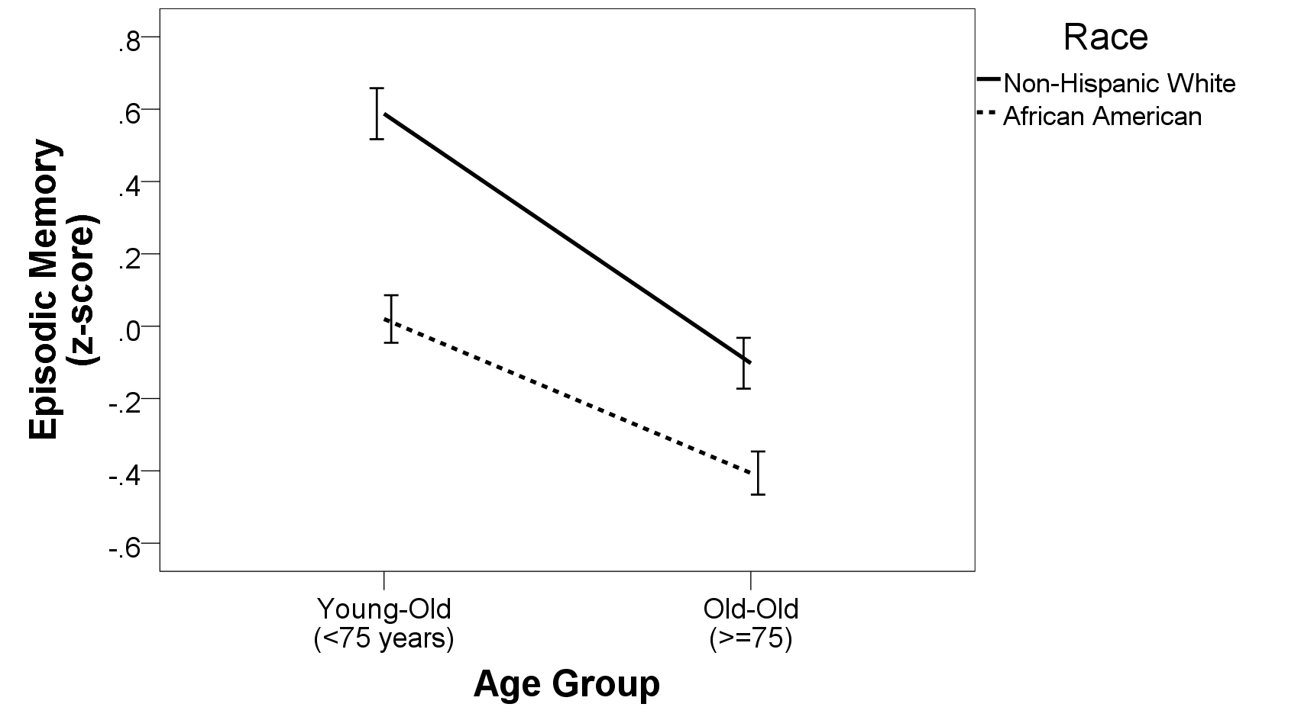
Evidence for age-as-leveler effects
WHICAP
Zahodne, Manly, Azar, Brickman, & Glymour, JAGS (2016)

Slide 14
Notes:
partial measurement invariance, demonstrated by invariant factor structure and factor loadings but nonequivalent observed score intercepts; Configural invariance, in which the structure of the model was constrained to be the same across the two language groups, was assessed by examining the overall fit of the model. Metric invariance, in which the magnitude of the corresponding factor loadings were constrained to be equal across the two language groups, was assessed by comparing the metric invariance model fit to the configural invariance model fit. Scalar invariance was evaluated by constraining corresponding intercepts to be the same across groups.

Slide 15
Blacks and Hispanics have more rapid memory decline as compared to Whites in WHICAP

Slide 16
Blacks and Hispanics have more rapid memory decline as compared to Whites in WHICAP
“Diagnostic threshold”

Slide 17
Causal pathways linking race, cognitive aging, and AD
History
Genetic Ancestry
Self or Other Identified
Race
Social
Factors
Biological factors
Cognitive Decline
Alzheimer’s Disease
Behaviors
Birth Region
Adapted from Marden et al., 2016

Slide 18
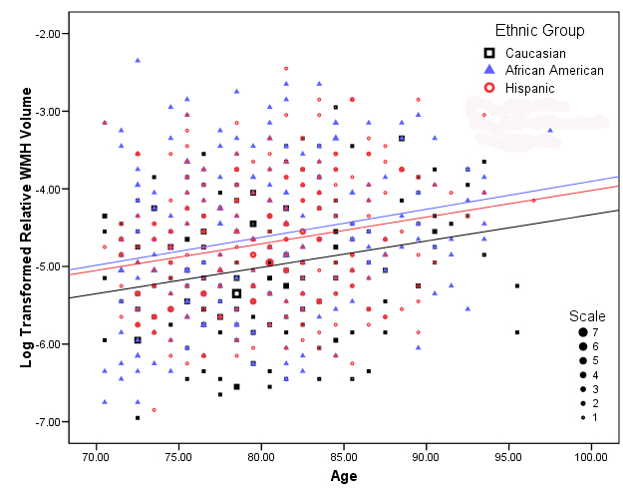
Biological Mediators of AD Disparities:
Age, ethnicity, and relative WMH volume
Brickman et al., Arch Neurol, 2008

Slide 19
WMH & language
Zahodne et al, CAR 2015

Slide 20
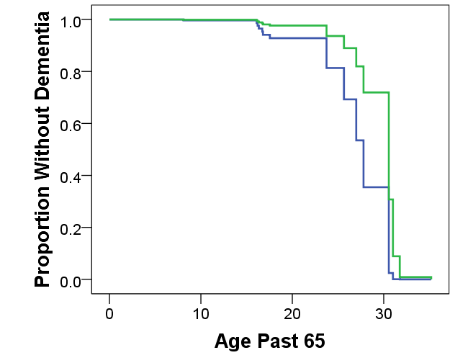
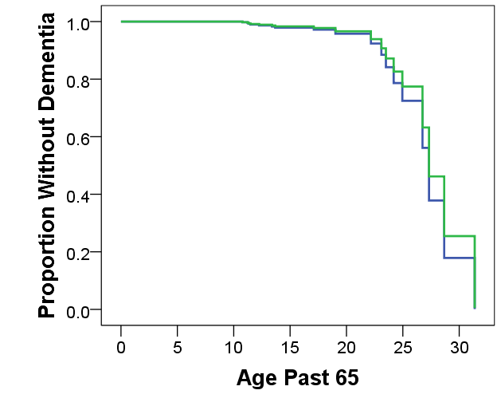
Hippocampal vol. & incident dementia
Hippocampal volume below sample mean
Hippocampal volume at or above sample mean
Non-Hispanic White
Non-Hispanic Black

Slide 21
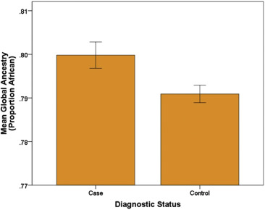
Admixture mapping
Higher levels of African ancestry (whole genome level and at specific AD-related genetic loci like ABCA7) are associated with an increased risk for AD
Hohman et al., 2015

Slide 22
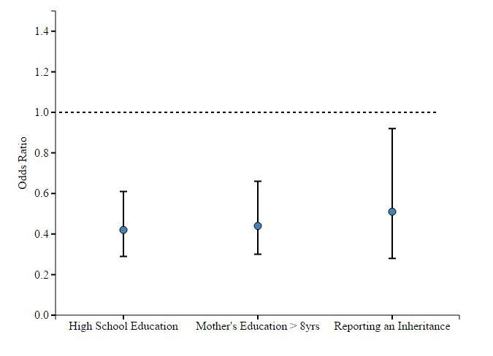
  Social factors correlate with African Ancestry and could confound relationship with AD
HRS non-Hispanic blacks
Comparing highest versus lowest quartile of African Ancestry
Higher African Ancestry is associated with
  Less education
  Fewer years of parental schooling
  No inheritance
  Lower income (about $1400/year)
  Less wealth (about $12,000)
Ancestry doesn't biologically mediate or influence these factors
African ancestry is a marker for social experiences of individual, parents and grandparents
Marden, Walter, Kaufman, & Glymour, (2016)
Accounting for socioeconomic status eliminated the association of European ancestry with lower risk of diabetes Colombia and attenuated the association in Mexicans (Flores et al., 2009)

Slide 23
School Quality
Educational attainment (years or credential) ignores tremendous variability in quality of schooling
  Race/ethnicity
  Geographic region
  Secular trends

Slide 24
Length of School Year

Slide 25
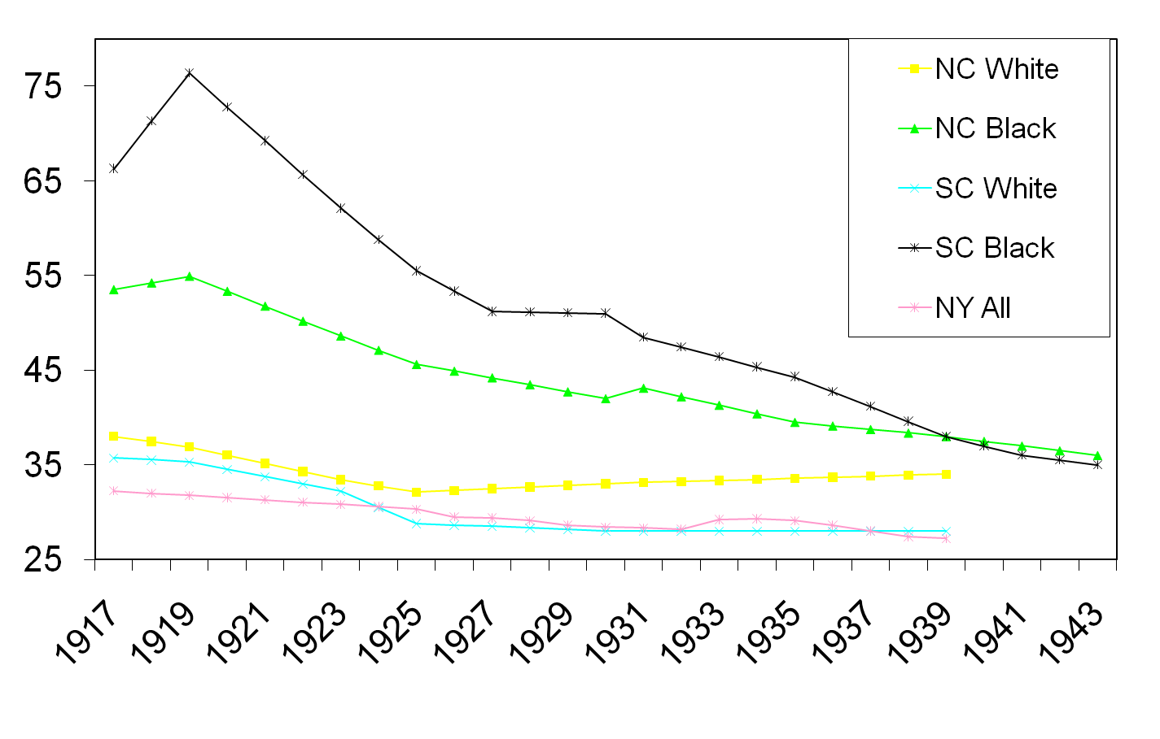
Student Teacher Ratio

Slide 26
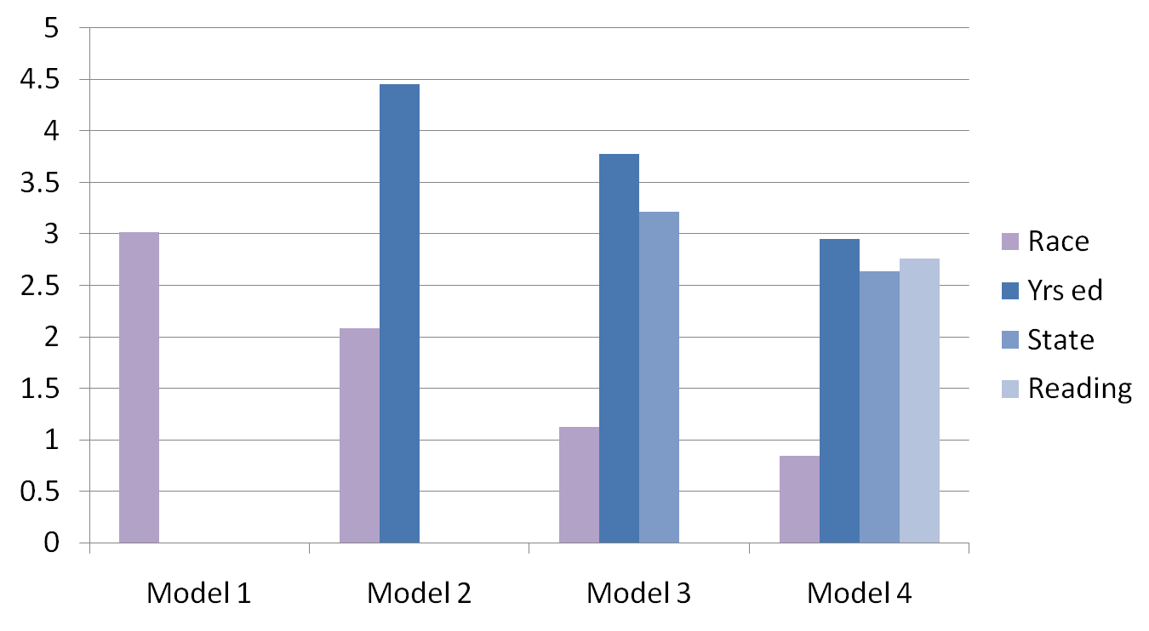
Determinants of cross-sectional language test performance
***
***
***
***
***
***
***
***
All models are adjusted for age and sex

Slide 27
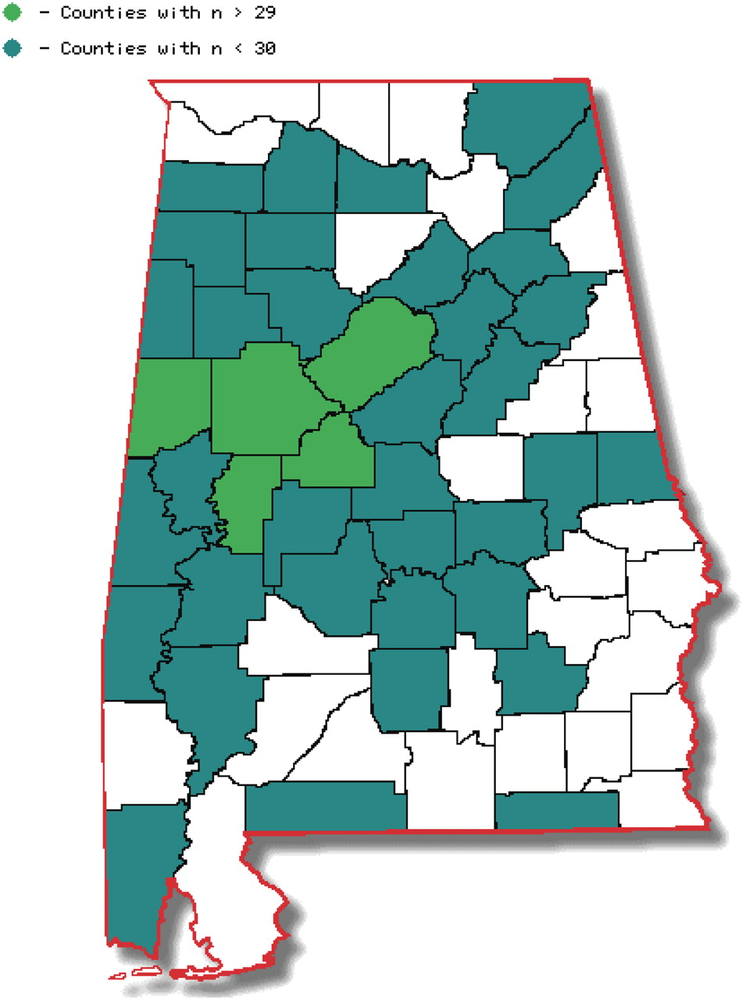
Alabama counties of residence during participants’ childhood schooling
Student–teacher ratio and school year length, not expenditures, were associated with baseline cognitive function
Independent of education level, age, race, gender, income, reading ability, vascular risk factors, and health behaviors
Associations were stronger in those with lower levels of education (≤12 years)
Not related to 4-year change in cognitive function
Michael Crowe et al. J Gerontol A Biol Sci Med Sci 2012
Notes:
Alabama counties of residence during participants’ childhood schooling.

Slide 28
Racial disparities by US region of primary school education in HRS
Liu, Glymour, Zahodne, Weiss, & Manly, JINS (2015)

Slide 29
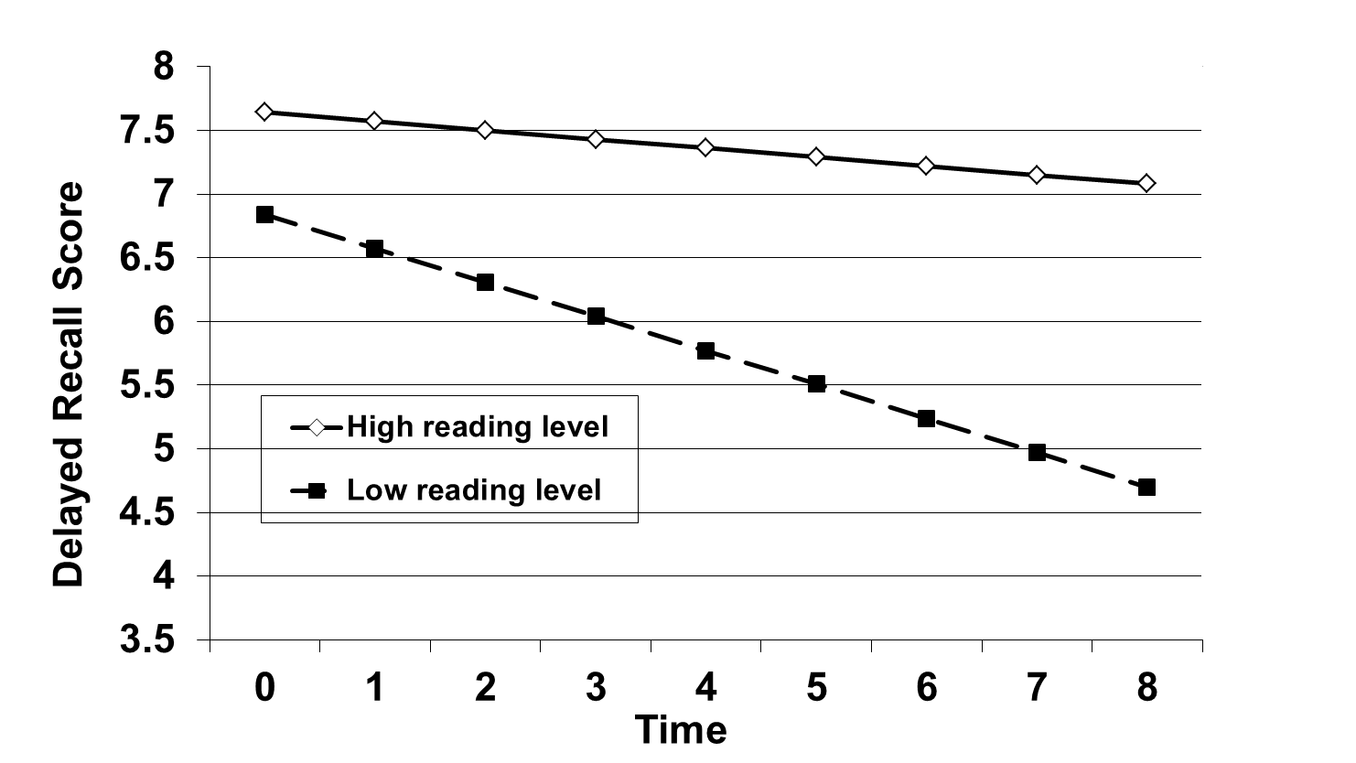
Reading level and Memory
Manly et al., JCEN 2003

Slide 30
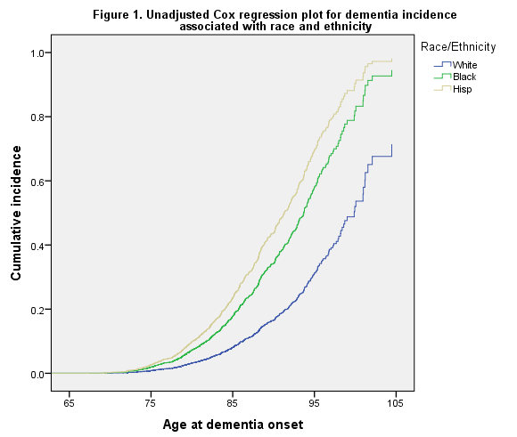
Disparities in WHICAP
Watson et al., in preparation

Slide 31
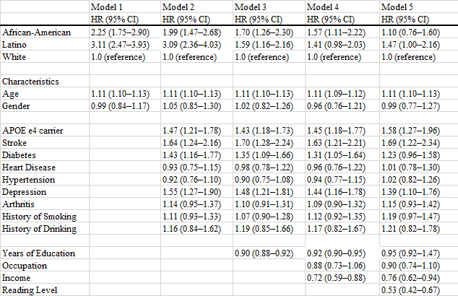
Mechanisms of AD Disparities in WHICAP
Watson et al., in preparation
Notes:
Age and Sex adjusted model, Hazard ratio for AD among Aas compared to Whites is 2.3 and for Hispanics is 3.1

Slide 32
Secular Trends in AD incidence by race
Schupf et al., under review
 | Model 1 | Model 2 | Model 3
 | HR (95%CI) | HR (95%CI) | HR (95%CI)
All Participants
1999 | 0.59 (0.49-0.72) | 0.62 (0.50-0.77) | 0.69 (0.55-0.86)
1992 | 1.0 (ref) | 1.0 (ref) | 1.0 (ref)
Non-Hispanic White
1999 | 0.60 (0.34-1.05) | 0.72 (0.35-1.47) | 0.80 (0.37-1.71)
1992 | 1.0 (ref) | 1.0 (ref) | 1.0 (ref)
African-American
1999 | 0.52 (0.36-0.73) | 0.65 (0.44-0.97) | 0.87 (0.57-1.34)
1992 | 1.0 (ref) | 1.0 (ref) | 1.0 (ref)
Hispanic
1999 | 0.64 (0.49-0.83) | 0.60 (0.45-0.79) | 0.62 (0.47-0.83)
1992 | 1.0 (ref) | 1.00 (ref) | 1.00 (ref)
Model 1 Including cohort as predictor, adjusted for age, sex, race/ethnicity, baseline memory complaints
Model 2: Model 1 plus diabetes, heart disease, stroke, hypertension, current smoking, and BMI
Model 3: Model 2 plus education

Slide 33
  Racial difference in benefit from cognitive intervention is mediated by psychosocial factors: ACTIVE trial
Zahodne, et al. (2015)

Slide 34
Conclusions
There are racial disparities in cognitive aging and AD
  Not attributable to assessment bias, although this is a major factor in some studies
  The independent effect of race on cognitive function is larger on intercept (cross-sectional) than on slope or change over time (longitudinal)
  Differences across studies may be attributable to differential recruitment, selection, and survival bias
  Declining trend of dementia incidence among African Americans is explained by secular increases in years of school
  Clinic-based cohorts are not appropriate for research on AD disparities
Biological, environmental, and sociocultural mediators of disparities have been examined
  Indicators of school quality explain racial disparities in cognitive function cross-sectionally and longitudinally, and AD incidence
  Intervening on psychosocial factors may narrow disparities in cognitive decline and improve response to interventions
  Sociocultural factors correlate with African Ancestry and may confound relationship of African Ancestry with AD risk or age at onset

Slide 35
Understanding the mechanisms of dementia disparities
Conduct studies designed to elucidate causal mechanisms
Longitudinal studies
  baseline prior to development of dementia (midlife or prior)
  repeat cognitive assessment
  importance of incidence and trajectory data
Measure educational experience, not just years attended or credential
Measure burden of neuropathology
Follow up into mid-life and later life needed for school, twin, and birth cohorts
Investigate potential critical periods (elementary vs. secondary; later life learning)
Evaluate natural experiments using instrumental variables
ADRD outcomes incorporated within planned interventions
  Increased income
  Improving neighborhood and household
  Values affirmation reduces stereotype threat/perceived racism

